Slide 1
Automatic Mediation Of Privacy-sensitive
Resource Access In
Smartphone Applications
Ben Livshits and Jaeyeon Jung
Microsoft Research

Slide 2
Permissions in Mobile Apps

Slide 3
Permissions Flavors
Permissions
Allow access
to GPS location?
OK
Cancel
OK
Cancel
installation-time
permissions
runtime
permissions

Slide 4
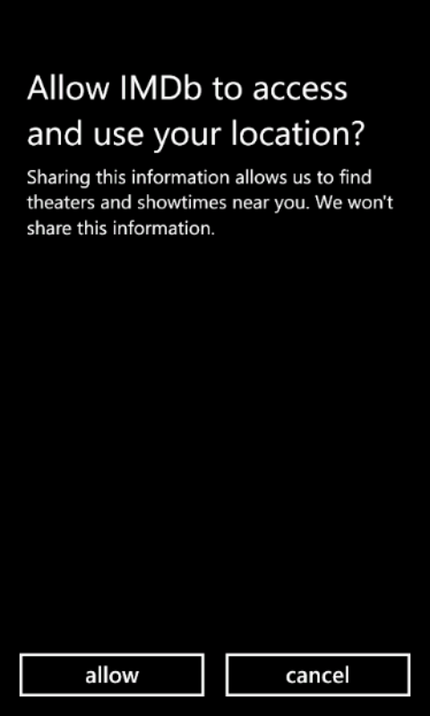
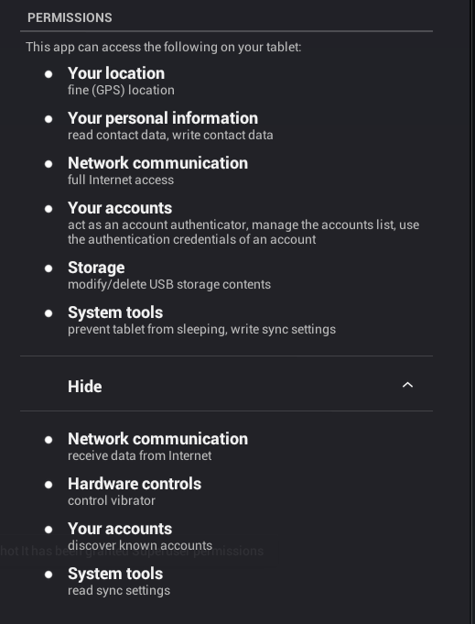
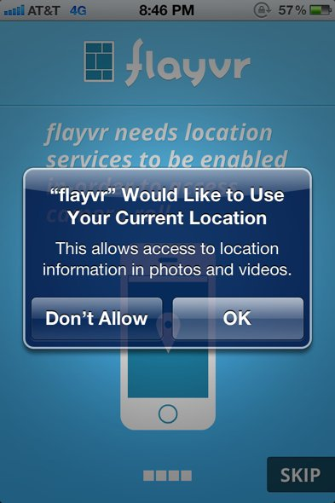
Examples of Permissions in Different Mobile Operating Systems
installation-time
permissions
runtime
permissions

Slide 5
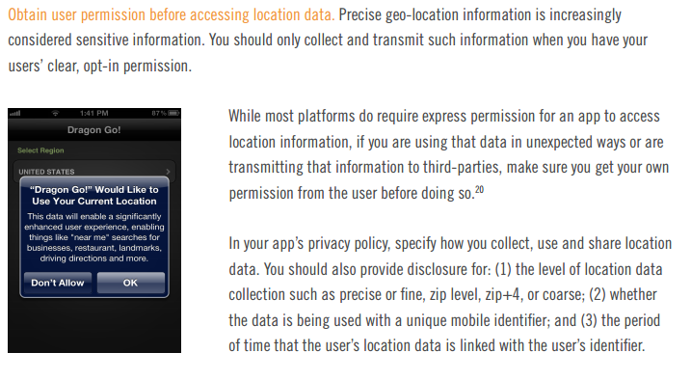
General Guidelines
Best Practices for Mobile Application Developers
Center for Democracy & Technology

Slide 6



Guarding Location Access
Focus on 3 representative applications in the Windows Phone store
App | Resource Accesses | APIs used | DLLs using location
AroundMe | 2 | TryStart, getPosition | AroundMe.dll
Burger King | 5 | Start, getPosition | BurgerKing.dll, GART.dll
LumiaClock | 2 | Start, getPosition | SOMAWP7.dll
%z
Notes:
Our focus for this work is on Windows Phone apps
The idea is that they have to prompt when accessing sensitive info such as location

Slide 7
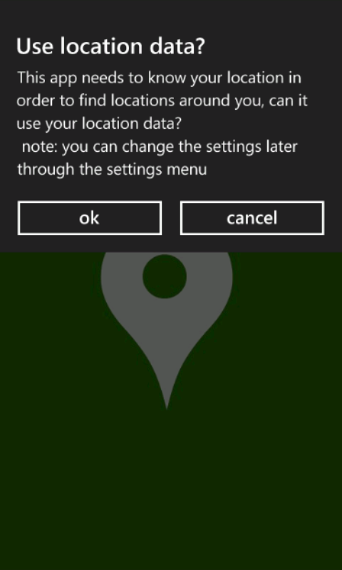
AroundMe
public static bool AroundMe.App.CheckOptin() {
if (((Option)Enum.Parse(typeof(Option),Config.GetSetting
(SettingConstants.UseMyLocation),true)) == Option.Yes) {
return GetCurrentCoordinates();
}
if (MessageBox.Show("This app needs ...",
"Use location data?", MessageBoxButton.OKCancel)
== MessageBoxResult.OK)
{
Config.UpdateSetting(new KeyValuePair<string,string>
(SettingConstants.UseMyLocation,Option.Yes.ToString()));
return GetCurrentCoordinates();
}
...
}
check
prompt
save
access

Slide 8
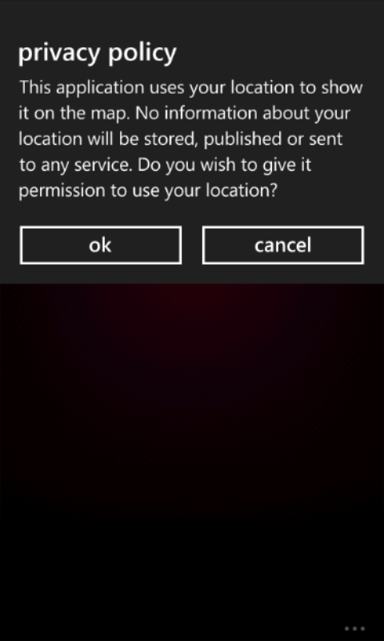
Burger King
public BurgerKing.View.MapPage() {
this.InitializeComponent();
base.DataContext = new MapViewModel();
this.BuildApplicationBar();
if (AppSettings.Current.UseLocationService){
this.watcher = new GeoCoordinateWatcher();
}
..
}
protected virtual void GART.Controls.ARDisplay.
OnLocationEnabledChanged(
DependencyPropertyChangedEventArgs e)
{
if (this.servicesRunning) {
if (this.LocationEnabled) {
this.StartLocation();
…
application code
library code

Slide 9
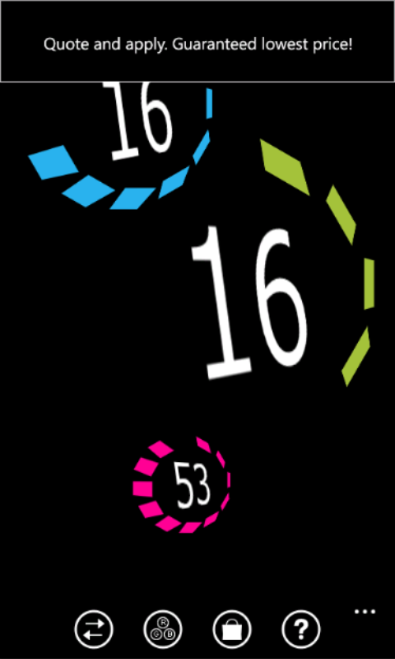
LumiaClock
public SomaAd()
{
...
this._locationUseOK = true;
...
if (this._locationUseOK) {
this.watcher = new GeoCoordinateWatcher
(GeoPositionAccuracy.Default);
this.watcher.MovementThreshold = 20.0;
this.watcher.StatusChanged +=
new EventHandler
<GeoPositionStatusChangedEventArgs>(
this.watcher_StatusChanged);
this.watcher.Start();
}
}
library:
just do it!

Slide 10
Where Does that Leave Us?
Properly protecting location access is challenging
Location access is common
  Some location-related code is in the app
  A lot of location access in third-party libraries
Location choices are sometimes ignored
Third-party libraries such as ad libraries sometimes expose flags for enabling location access but those are frequently ignored by developers

Slide 11
1
Contributions
Study how existing applications implement resource access prompts on a set of Windows Phone applications

Slide 12
2
Static analysis
Formulate a problem of valid prompt placement in graph-theoretic terms
Propose a static analysis algorithm for correct resource access prompt placement

Slide 13
3
Evaluation
We evaluate our approach to both locating missing prompts and placing them when they are missing on 100 apps
Overall, our two-prong strategy of dominator-based and backward placement succeeds in about 95% of all unique cases
Our analyses run in seconds, making it possible to run them as part of the app submission process

Slide 14
Analysis Approach

Slide 15
In This Paper…
We focus on a completely automatic way to insert missing prompts
Our approach is static: we want to be able to check for missing prompts and insert compensating code even if we cannot hit it at through runtime testing
Graph-theoretic approach
  Represent the application statically as a graph
  An inter-procedural version of control flow graph (CFG)
  Reason about prompt placement in graph-theoretic terms
Not information flow
  A lot of work on finding undesirable information flows
  We reason about control flow not data flow

Slide 16
Challenges
Avoiding double-prompts
Sticky prompts
Avoiding weaker prompts
Minimizing prompting
Avoiding prompts in background tasks
Avoiding prompts in libraries
if(P) l1 = getLocation();
l2 = getLocation();
flag = true;
if(P){
prompt();
flag = true;
l1 = getLocation();
}
if(!flag){
prompt();
l2 = getLocation();
}
if(P){
prompt();
l1 = getLocation();
l2 = getLocation();
}else{
prompt();
l2 = getLocation();
}

Slide 17
Challenges
Avoiding double-prompts
Sticky prompts
Avoiding weaker prompts
Minimizing prompting
Avoiding prompts in background tasks
Avoiding prompts in libraries
if (MessageBox.Show(
"This app needs to know your location
in order to find locations
around you, can it use your location data?
note: you can change the settings later
through the settings menu",
"Use location data? ", 1) == 1)
{
Config.UpdateSetting(
new KeyValuePair<string, string>(
SettingConstants.UseMyLocation,
Option.Yes.ToString()));
return
GetCurrentCoordinates();
}

Slide 18
Challenges
Avoiding double-prompts
Sticky prompts
Avoiding weaker prompts
Minimizing prompting
Avoiding prompts in background tasks
Avoiding prompts in libraries
3rd party.dll

Slide 19
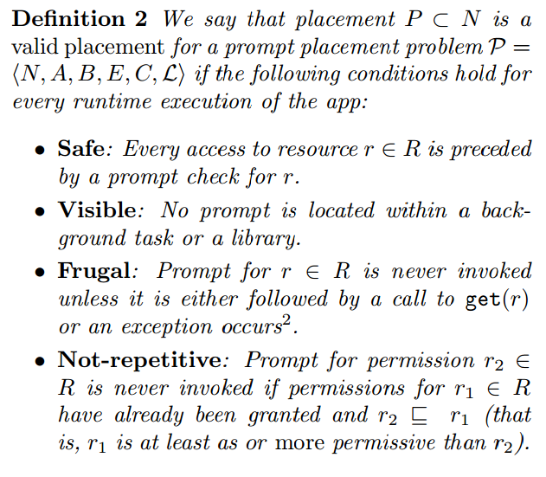
Valid Placement

Slide 20
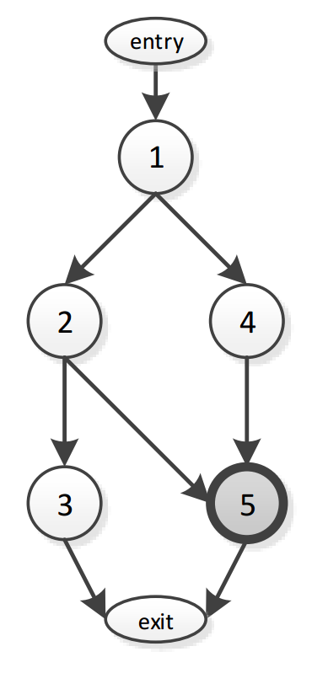
Intuition for Placement
Start with a resource access
“Move” the prompts up until we are outside of background tasks
Downside:
  possible to move these prompts too far (to the beginning of the app in the most extreme case)
  This would violate the frugal requirement.
  This gives rise to a notion of a prompt being needed at a particular point, for which we use the term anticipating
5
getLocation()

Slide 21
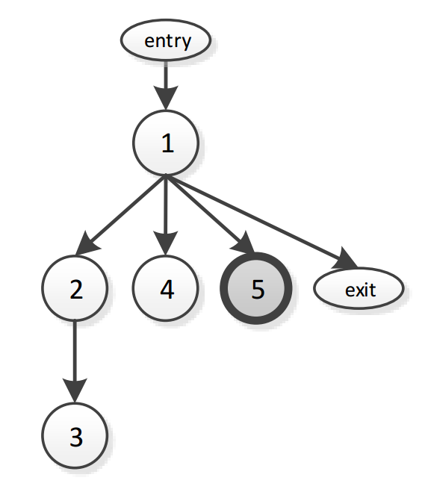
Dominator-Based Approach
1
5
5
getLocation()
Not frugal!

Slide 22
Backward Placement
2
4
5
getLocation()
5
Slower

Slide 23
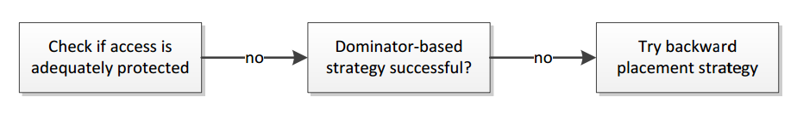
Analysis Steps
For every resource access type and every node n, pre-compute r-anticipated value A_{r}(n)
Merge values by meeting them in the semi-lattice of resource types
A(n) = ᴧ A_{r}(n)
For every

Slide 24
Evaluation

Slide 25
Input Statistics
apps analyzed app size | 100 7.3MB
processed methods | 352,816 | 3.5K on average
background/library methods | 26,033 | 7%
library methods | 25,898 | 7%
nodes | 1,333,056
anticipating | 171,253 | 12%
accesses | 227 | 2 per app
accesses in background/library methods | 78 | 1/3rd

Slide 26
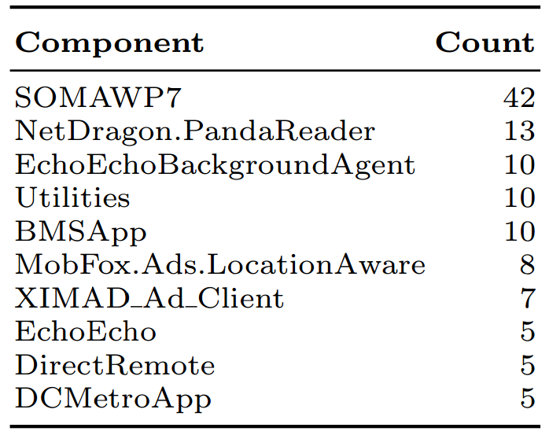
Benchmarks
Took 100 WP 7 apps
To make this meaningful, chose apps with LOCATION and NETWORKING caps
An average app is 7.3 MB of code
Uses third-party ad libraries

Slide 27
Prompt Placement Success

Slide 28
Dominator-Based vs. Backward
When dominator-based placement succeeds, it is usually immediate
Backward placement is helpful for cases where dominator-based placement fails
However, some of these cases are still too hard, leading to 7 unique failures

Slide 29
Timing

Slide 30
Manual Examination
Picked 10 apps with 27 resource accesses
Manually exercised as much functionality as possible
Verification includes running these apps in an emulator to collect network packets and API calls
False negatives: resource access we think is protected whereas in fact at runtime it has no preceding prompts
Out of 27 accesses our analysis reports 10 as unprotected
No false negatives observed: analysis correctly identifies them as unprotected and finds proper prompt placements

Slide 31
False Positives
False positives: analysis classifies a resource access as unprotected whereas it is properly protected at runtime
11 out of 21 accesses found as unprotected turn out to be false positives
Reasons include:
  Not recognizing sticky prompts
  Custom consent dialogs
  Async calls and XAML
Our analysis errs on the safe side, introducing false positives and not false negatives
False positives may lead to double-prompting
  Inserted prompts are sticky, so at most one extra runtime prompt per app
  Easy to spot and suppress by app store maintainers
Interesting future research

Slide 32
Conclusions
Explored the problem of missing prompts that should guard sensitive resource accesses
Graph-theoretic algorithm for placing prompts
Approach that balances execution speed and few prompts inserted via dominator-based placement with a comprehensive nature of a more exhaustive backward analysis
Overall, our two-prong strategy of dominator-based and backward placement succeeds in
  about 95% of all unique cases
  highly scalable: analysis usually takes under a second on average
Suggests that fully-automatic prompt placement is viable
Notes:
Automatic checking and placement can be done both by developers and app store maintainers

